Slide 1
Notepad ++ tips & tricks
Ms. Amal AlEidi

Slide 2
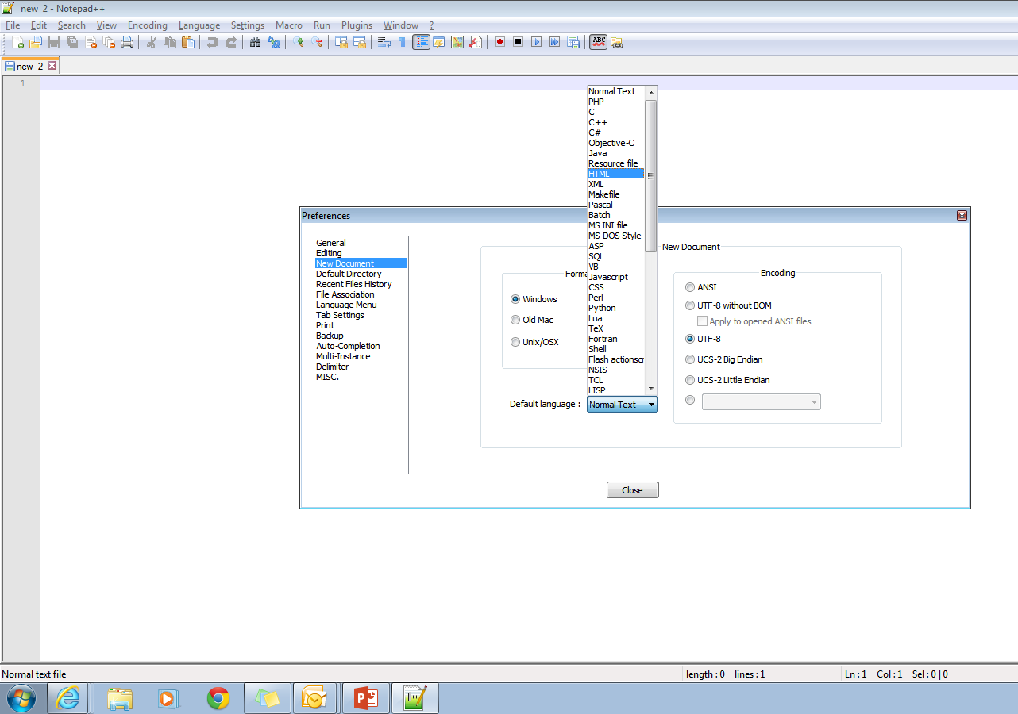
Choosing Default Language
Each time you add a new file it will treat your file as an HTML File (coloring and highlighting is added).
Setting → preferences → new Document

Slide 3
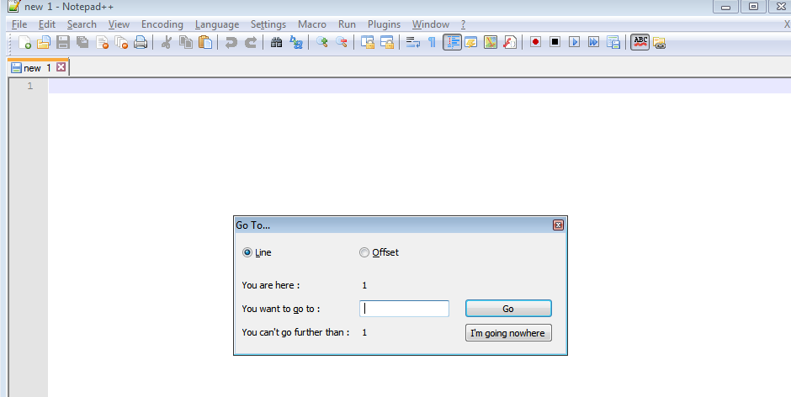
Search for the line number
CTRL + G brings up a search box to write the line number

Slide 4
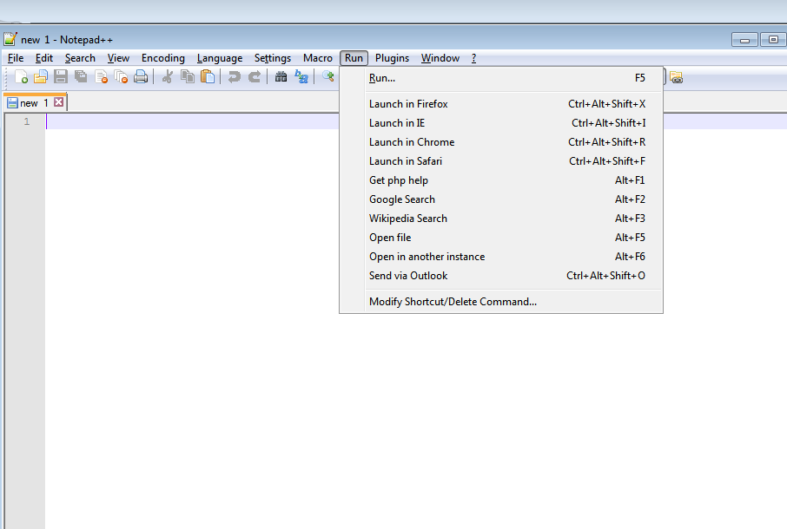
Launch within your browser

Slide 5
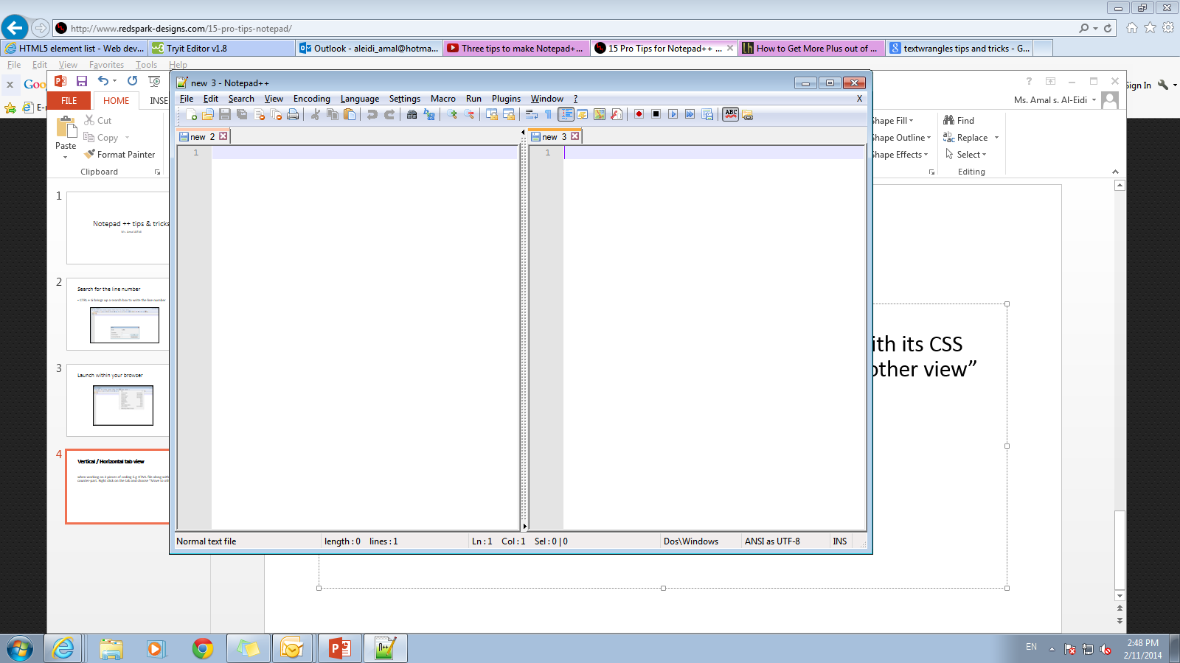
Vertical / Horizontal tab view
when working on 2 pieces of coding E.g HTML file along with its CSS counter-part. Right click on the tab and choose “Move to other view”

Slide 6
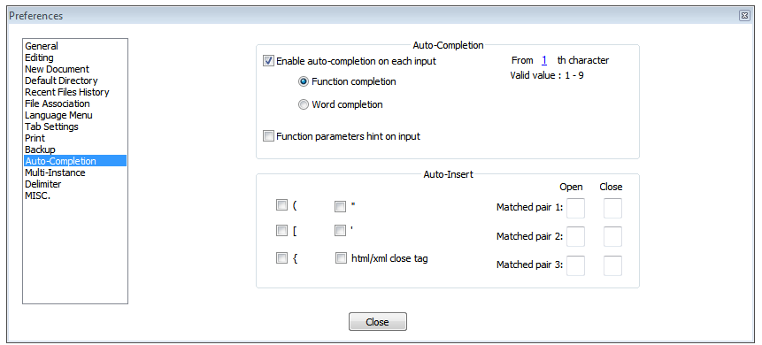
Auto-completion
As you type tags you will get a dropdown list with different HTML tags you can use.
Setting → preferences → auto-completion

Slide 7
TextFX plugin
Helps to keep our tags properly closed.
Plugins → plugin Manager → show plug in manager → TextFX
This will give you a new TextFX menu

Slide 8
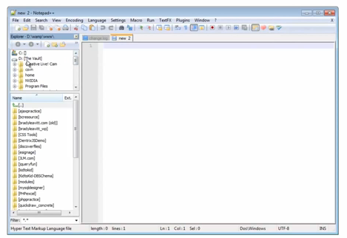
The Explore plugin
Gives you a tree view of your website
Plugins → plugin Manager → show plug in manager → explore.
After the installation activate the plugin by going to:
Plugin → Explore

